Slide 1
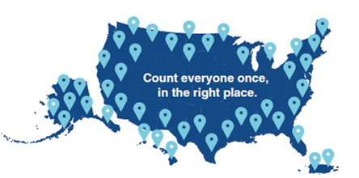
Road to 2020 Census
Final Stages of Operations, Media Promotion, and Outreach
Presented by
Pauline Nunez, Partnership Coordinator, U.S. Census Bureau-Denver Region
Virtual Annual Meeting
Arizona State Data Center
Arizona Office of Economic Opportunity
Tuesday, September 15th, 2020

Slide 2
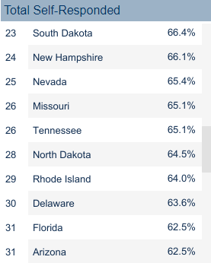
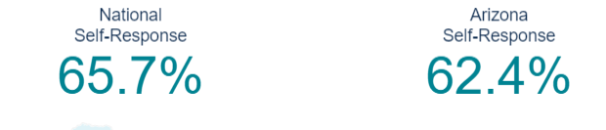
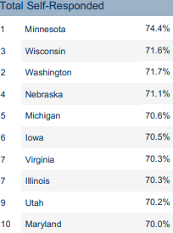
Arizona Response Rates
Apache 19.6%
Cochise 60.2%
Coconino 44.3%
Gila 40.8%
Graham 55.3%
Greenlee 40.2%
La Paz 23.5%
Maricopa 66.5%
Mohave 58.6%
Navajo 32.2%
Pima 65.9%
Pinal 56.6%
Santa Cruz 56.7%
Yavapai 64.7%
Yuma 47.2%
https://2020census.gov/en/response-rates.html

Slide 3
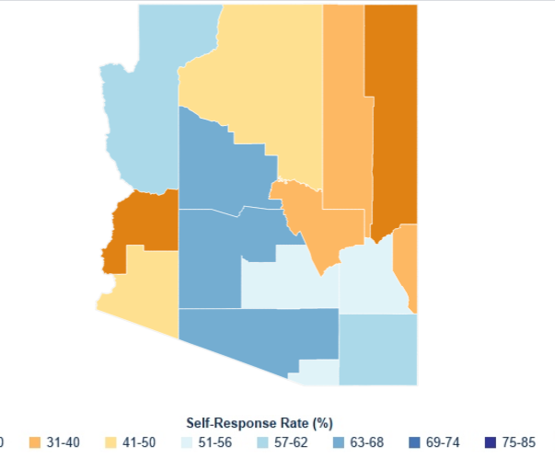
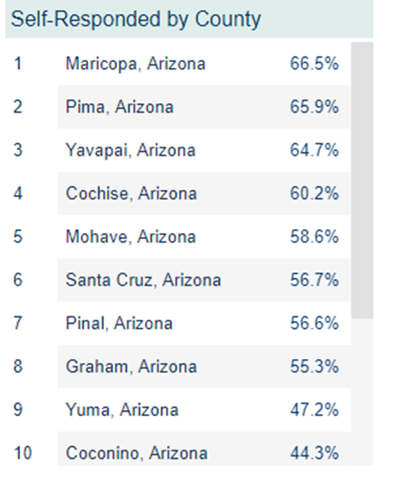
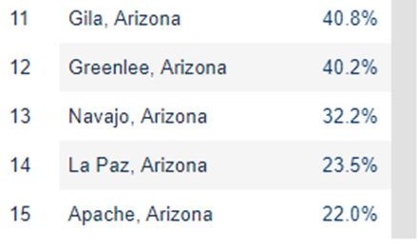

Slide 4
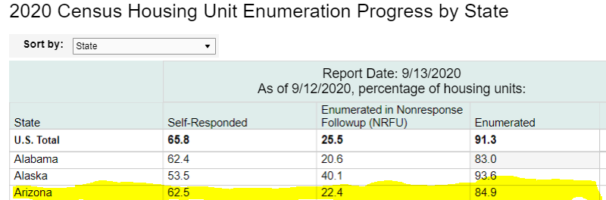
https://2020census.gov/en/response-rates/nrfu.html

Slide 5
2020 Census Timeline
July 13th – September 30- Mobile Questionnaire Assistance (MQA) sites
August 7th - Begin Non-Response Follow Up (NRFU, in person interviews)
August 31st – September 28th – Enumeration of Transitory Locations (Marinas, Hotels, etc.)
September 22nd – September 24th – Service Based Enumeration (Homeless Population Count)
September 23rd – December 22nd – Post Enumeration Survey
December 31st, 2020 Census Counts to President
2020 Census Operational Adjustments Due to COVID-19
Notes:
The 2020 Census operation to count people living in transitory locations is underway. The operation will count those living in housing such as RV parks, campgrounds, marinas, and temporary housing such as hotels and motels. The operation also counts people living at racetracks, carnivals and circuses, and will continue until Sept. 28.
The transitory population will be interviewed in person by one of more than 12,500 census takers who will be equipped with personal protective equipment (PPE) and trained to observe social distancing protocols.

Slide 6
Federal Court Order
Important Information Related to Census Bureau’s Compliance with Today’s Federal Court Order
SEPTEMBER 05, 2020
Guidance for Census Bureau Field Employees
A federal district court for the Northern District of California issued a temporary restraining order at 9:29 PM EDT on 9/5/2020 in the case of National Urban League v. Ross, No. 20-05799. The Order provides that the Census Bureau and the Commerce Department "are enjoined from implementing the August 3, 2020 Replan or allowing to be implemented any actions as a result of the shortened timelines in the August 3, 2020 Replan, including but not limited to winding down or altering any Census field operations, until the Court conducts its September 17, 2020 hearing on Plaintiffs’ PI motion.”
The Census Bureau and the Commerce Department are obligated to comply with the Court’s Order and are taking immediate steps to do so.
Enumeration will continue.

Slide 7
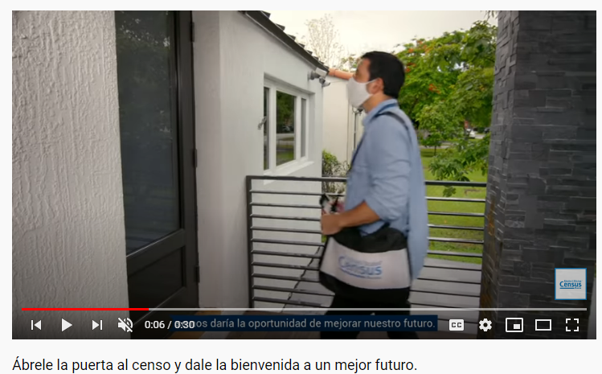
Media Campaign Update
The Census Bureau will continue its communications campaign through September 2020.
New advertisements are aimed at increasing online response to the 2020 Census while much of the nation remains at home practicing social distancing.
This includes an increase in digital, radio, and print media.

Slide 8
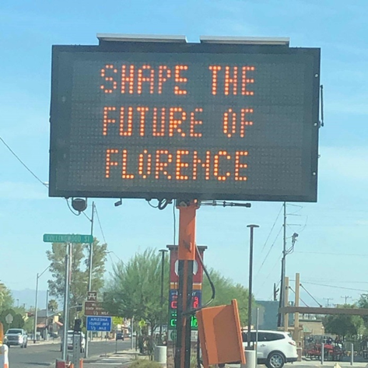
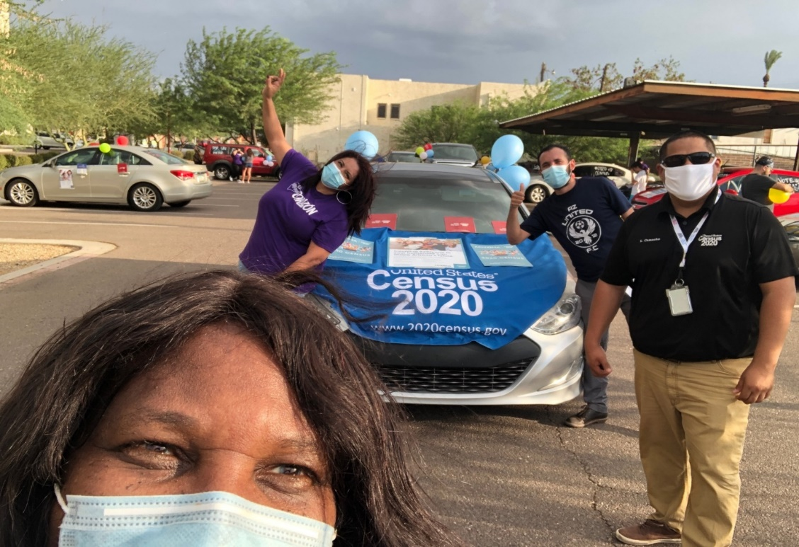
Mobile Questionnaire Assistance
The Census Bureau’s Community Partnership and Engagement Program (CPEP) has resumed in-person events at locations where it is safe to do so and is continuing to conduct virtual events.
Arizona MQA Hosted:
Univision (Census Week)
Groceries (Ranch Market, H-Mart, LAMS Markets)
Pharmacies (Walgreens)
State Agencies (Department of Transportation
Food banks (St. Mary’s Food Banks)
Neighborhood association gatherings (City of Phoenix Neighborhood Associations)
Appointments/Promotoras (Hispanic, Senior, Refugee, CPLC, Somali Community)
Community Phone Bank (OneAZ TelEstravanganza)

Slide 9
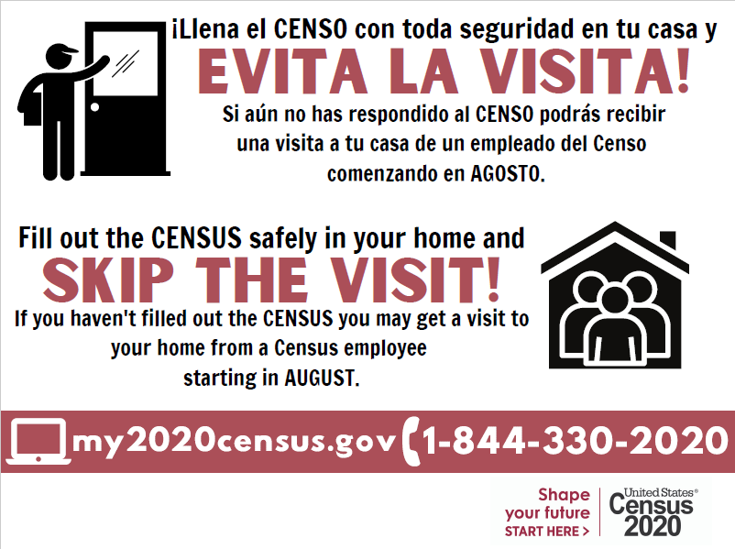
Sample Social Media
Responses to the #2020Census shape decisions about how billions of dollars in federal funds flow into our community each year for the next 10 years for critical services. Respond today at 2020Census.gov

Slide 10
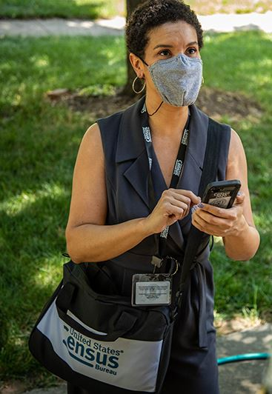
Door-to-Door Visits Begin Nationwide for 2020 Census
Census takers are visiting homes that haven't responded to the 2020 Census. Enumerators will collect residents’ answers to interview questions or information about the status of the housing unit (for example, vacant or nonexistent).
If the enumerator is unsuccessful at contacting someone in the household, they will leave a Notice of Visit at their door. If all attempts to contact are unsuccessful, an enumerator will obtain as much information as possible about the household from a neighbor, building manager, or another reliable source.

Slide 11
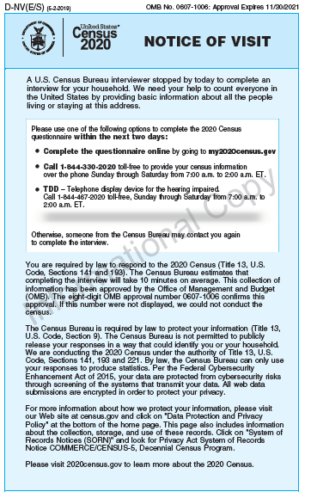
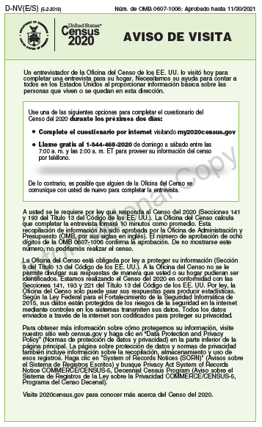
Notice of Visit

Slide 12
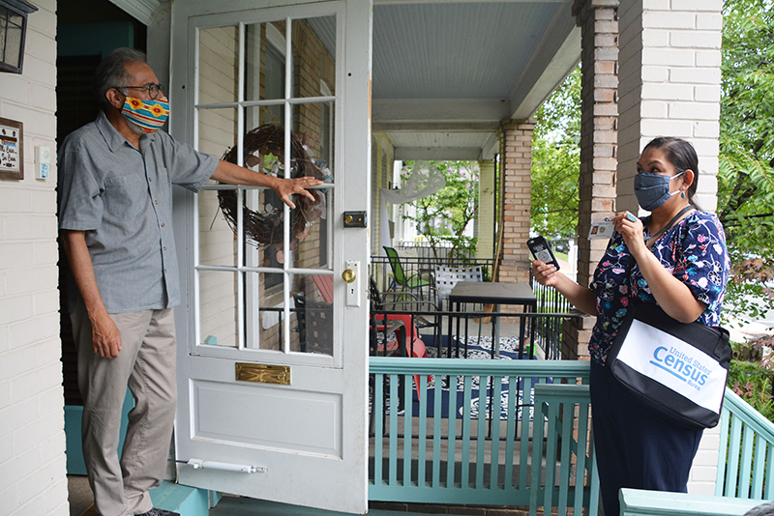
NRFU Health and Safety Guidelines
In carrying out our mission, the U.S. Census Bureau is committed to protecting the health and safety of those we serve and employ. Census takers are trained to follow CDC recommendations to mitigate any risk of transmission:
Wearing of face masks.
Mask will be provided upon request of residents
Maintaining social distance
Practicing hand hygiene.
Not entering homes,
Conducting interviews outside as much as possible or practical.
Joint Statement from the Census Bureau and Centers for Disease Control on Conducting 2020 Census Non-Response Follow-Up Interviews

Slide 13
How to Identify a Census Worker
How Can You Verify That Someone Is a Census Taker?
They will have a valid ID badge with their photograph, a U.S. Department of Commerce watermark, and an expiration date.
Census workers will also carry Census Bureau bags and other equipment with the Census Bureau logo.

Slide 14
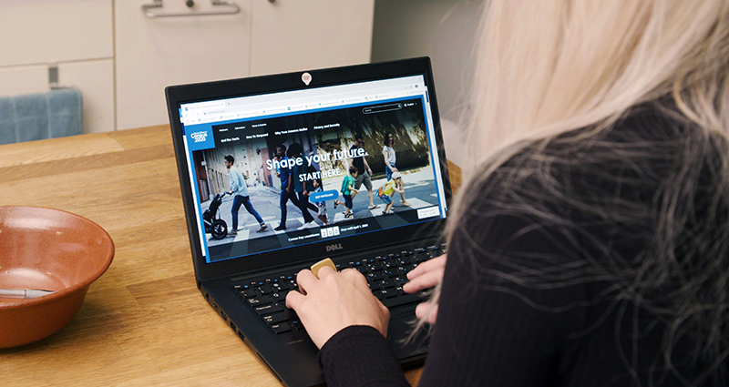

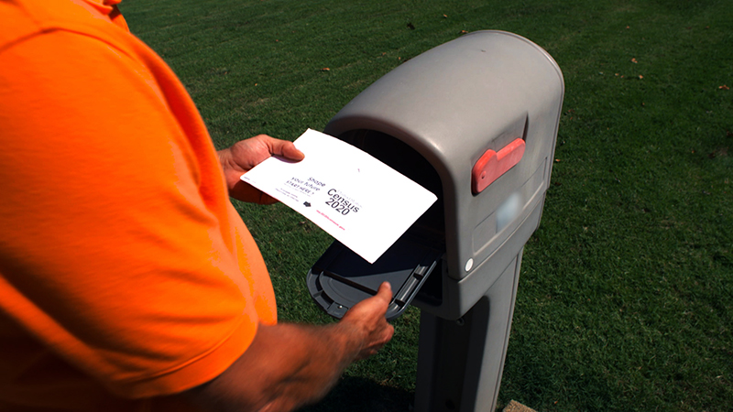
The time to respond is NOW!
Even though we are knocking on doors, Arizonans can still self-respond online, by phone, or by mail. Remember the most accurate census is a self response census. Encourage your constituents to visit:
2020census.gov or call 844-330-2020 -or- 844-468-2020 (Spanish)

